Slide 1

BookBoxBook
Mid-Demo
team GoNaMi
Hoyun Ko
Yuseon Nam
Seungyun Lee

Slide 2
Index
01
About BookBoxBook
02
Implementation until Now
03
Application UI
04
What to do

Slide 3
1
About BookBoxBook

Slide 4
Book Box Book
Efficient
“Used Books Trading Service
for University Students”
Secure
Money Saving

Slide 5




BookBoxBook
BookBoxBook
1. Register Book
BBB
seller
App
buyer
BookBox

Slide 6

BookBoxBook
BookBoxBook
BBB
1. Register Book
seller
App
2. Purchase Book
buyer
BookBox

Slide 7
BookBoxBook
BookBoxBook
BBB
1. Register Book
3. Reserve BookBox
seller
App
2. Purchase Book
buyer
BookBox

Slide 8
BookBoxBook
BookBoxBook
BBB
4. Put a Book
seller
App
buyer
BookBox

Slide 9
BookBoxBook
BookBoxBook
BBB
seller
4. Put a Book
App
5. Take a Book & Confirm
buyer
BookBox

Slide 10
BookBoxBook
BookBoxBook
6. Get Money
BBB
seller
4. Put a Book
App
5. Take a Book & Confirm
buyer
BookBox

Slide 11
2
Implementation Until Now

Slide 12
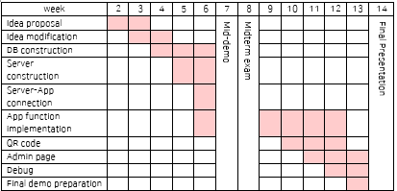
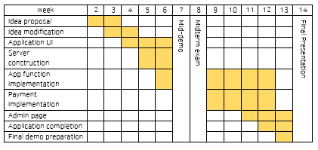
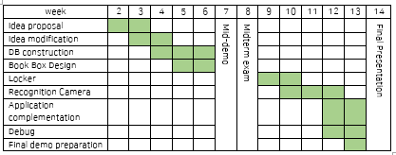
Hoyun Ko
Yuseon Nam
Seungyun Lee
Raspberry Pi Setting

Slide 13
Implementation until Now
1. Application
UI almost done! (80%)
Functions in progress (30%)
2. Server
Construction complete! (100%)
Connection(App-Server) in progress(60%)
3. DB construction complete!(100%)

Slide 14
Implementation until Now
Functions Complete (30%)
Log in & Sign up & Log out
Automatic Log in
Barcode recognition
Book information

Slide 15
Implementation until Now
Functions in Progress (70%)
List View of Search, Book Mark, Sell and Buy
Upload and save photos
University API
etc…

Slide 16
3
Application UI

Slide 17
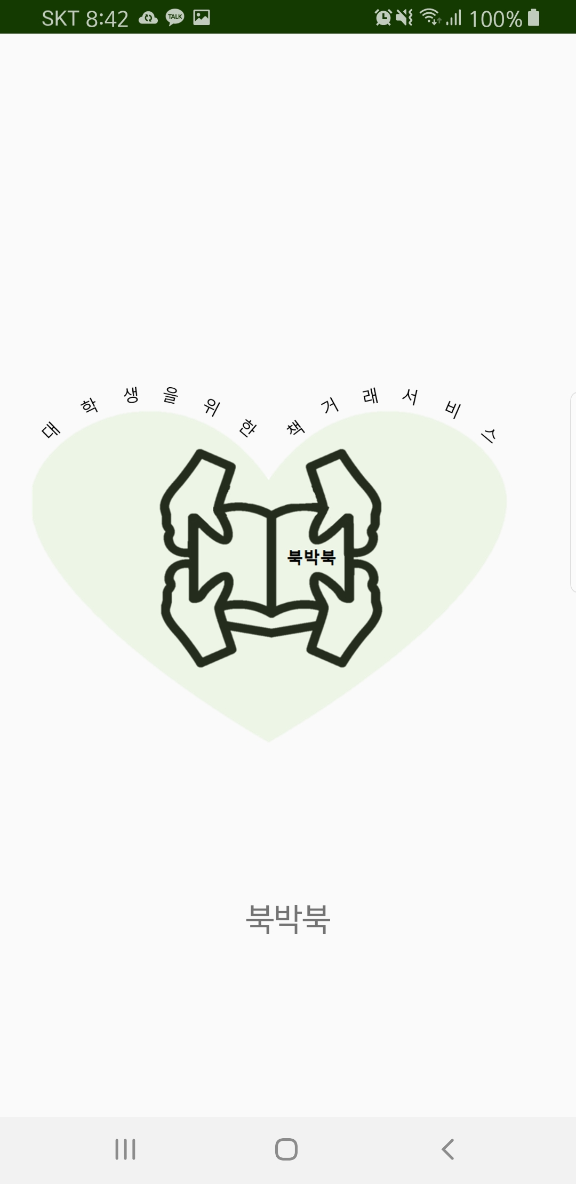
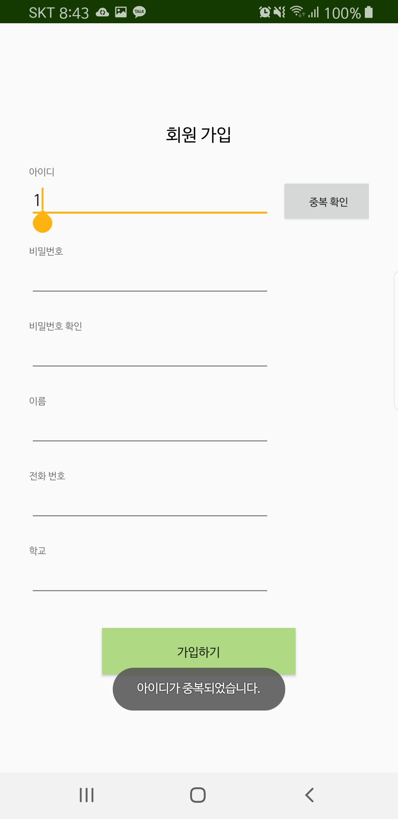
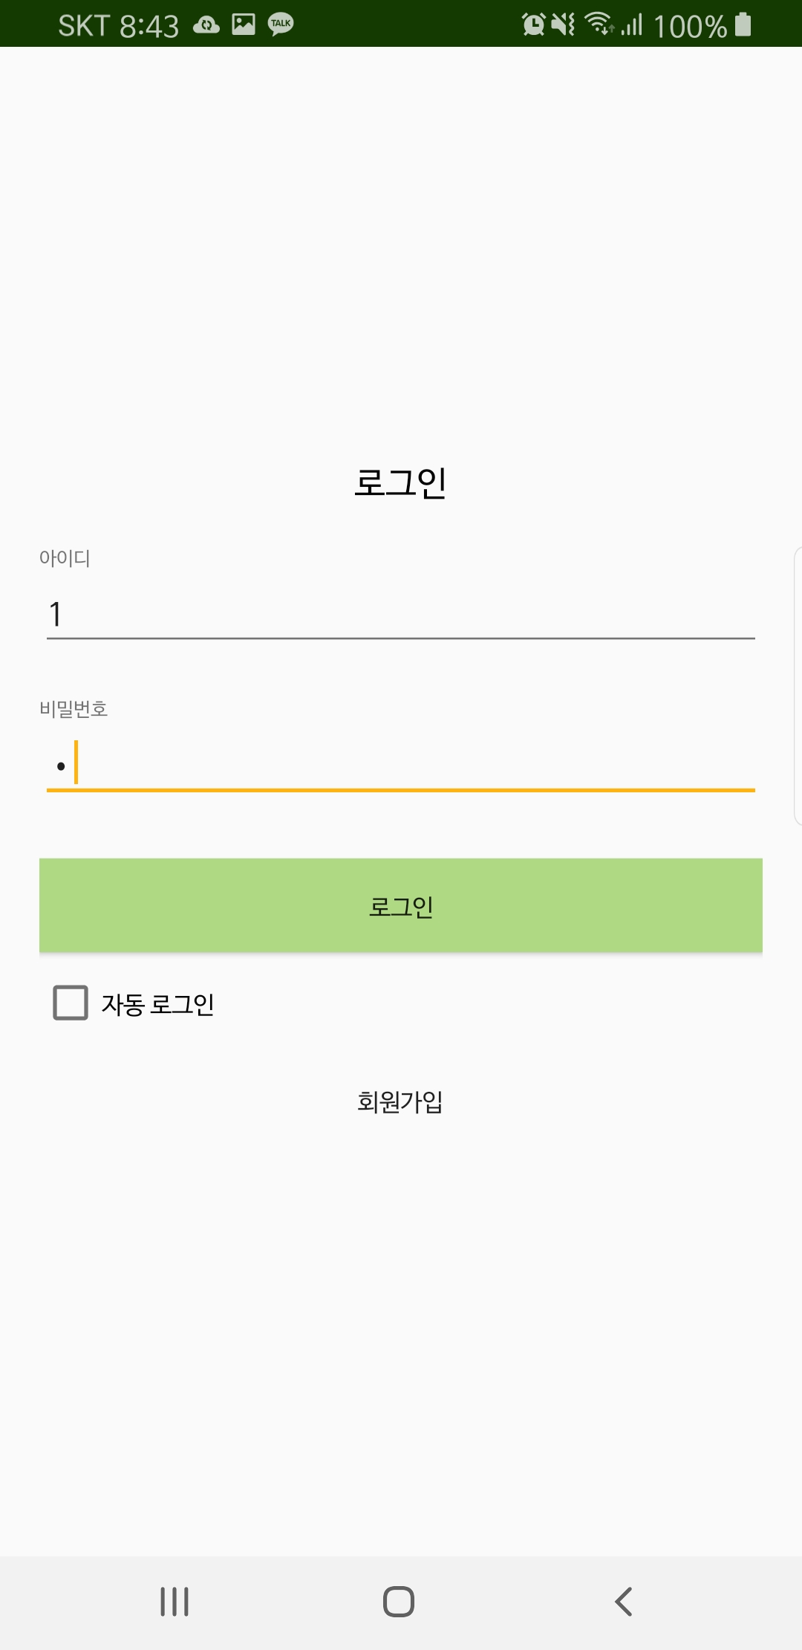
Intro & Sign Up & Log in

Slide 18
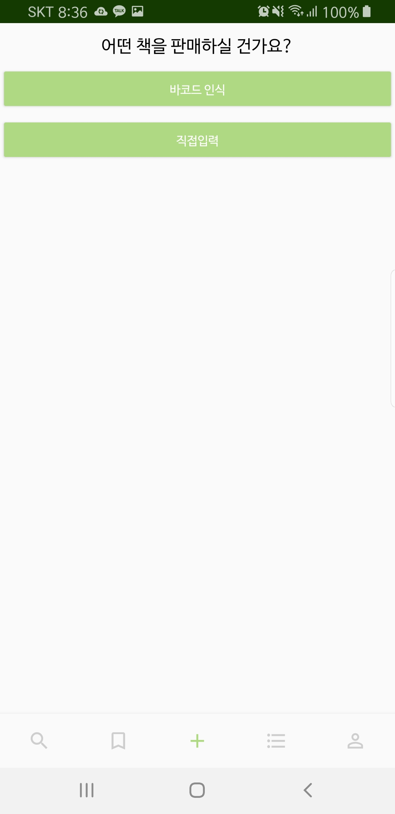
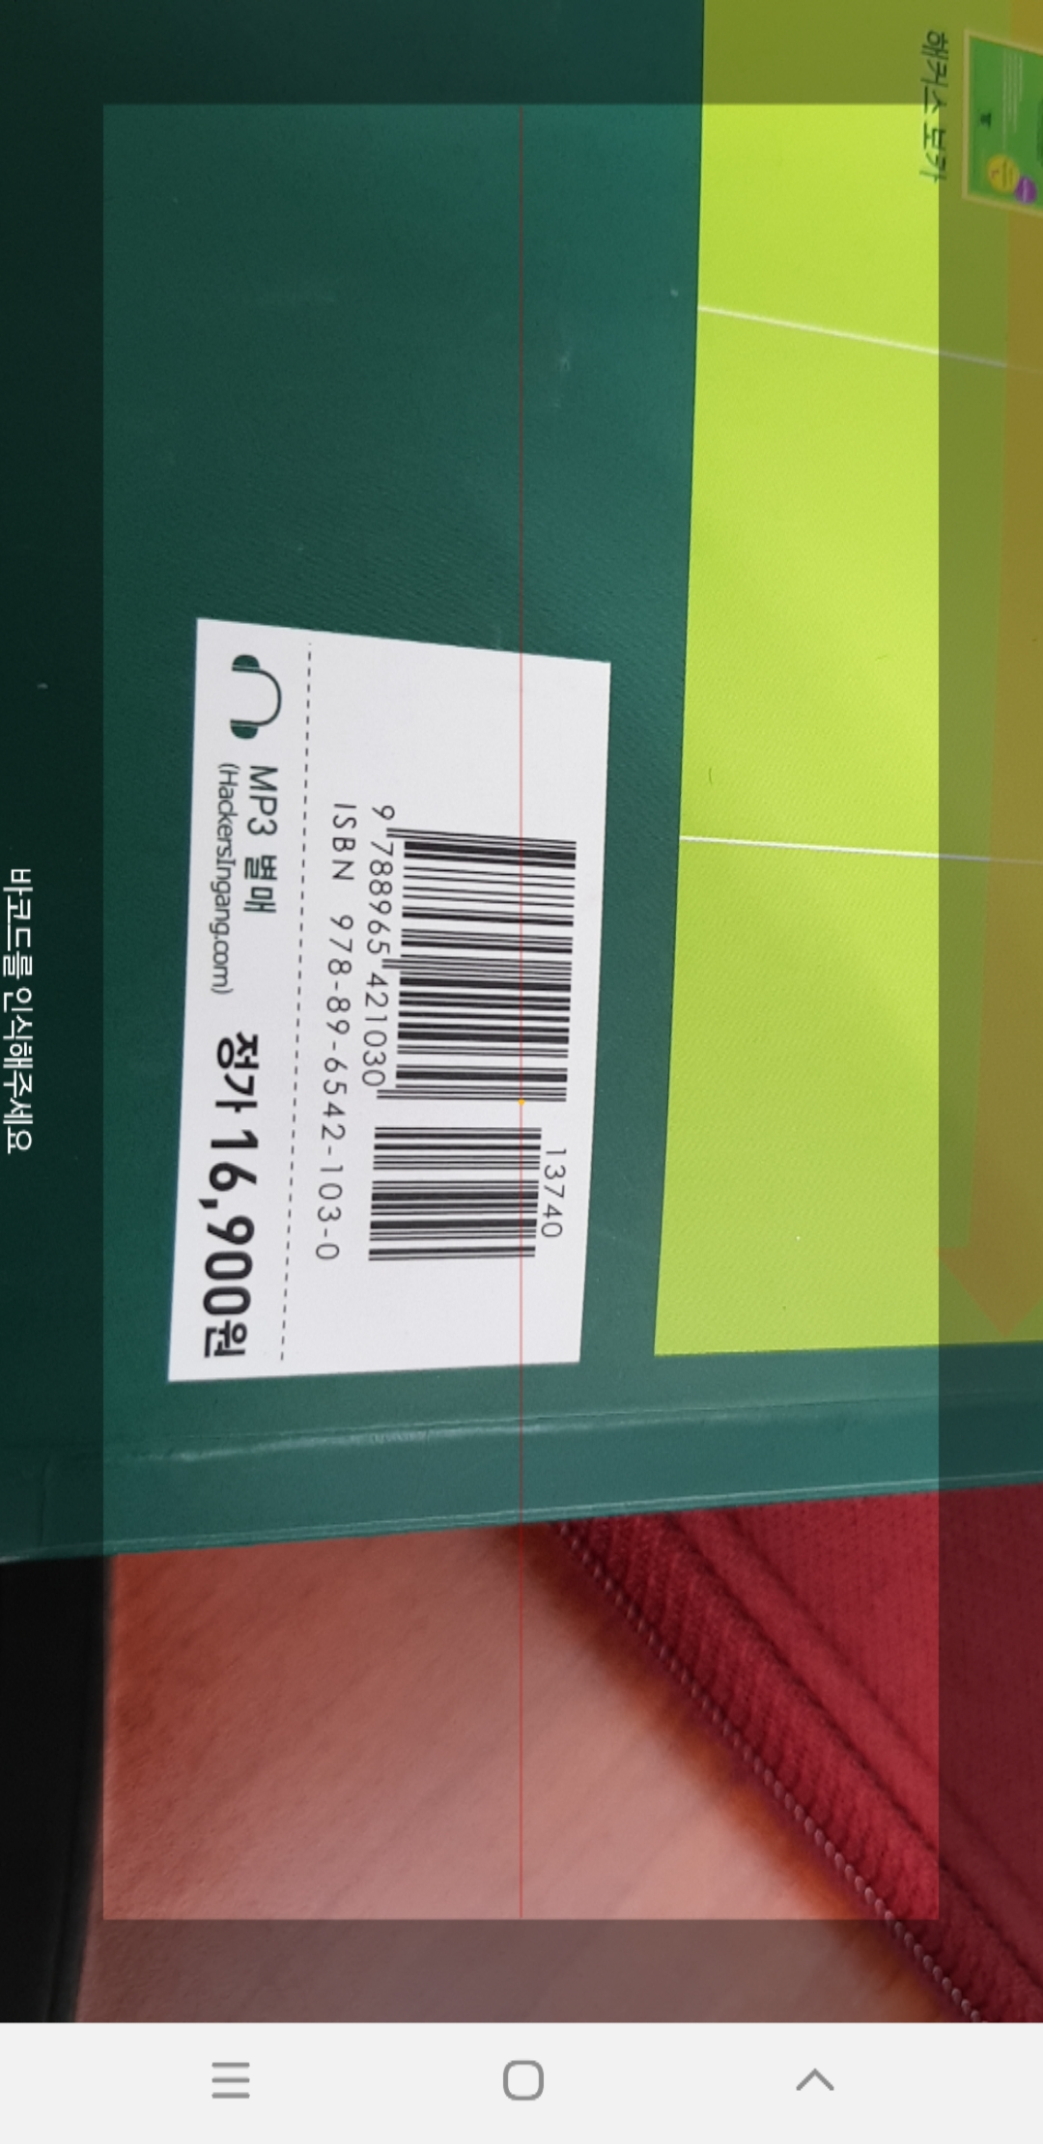
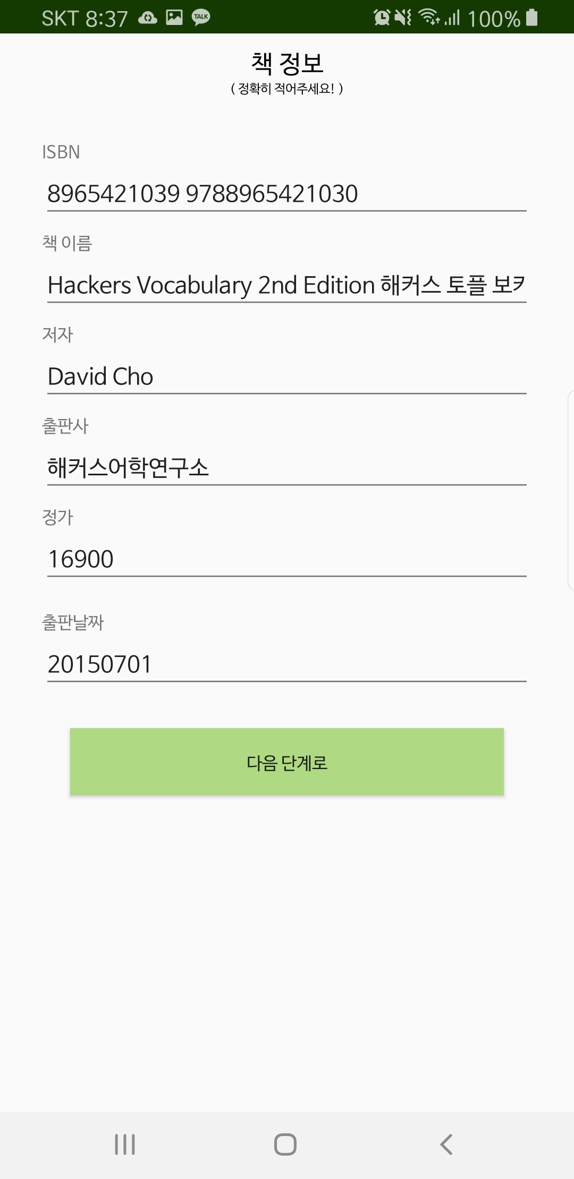
2. Barcode Recognition

Slide 19
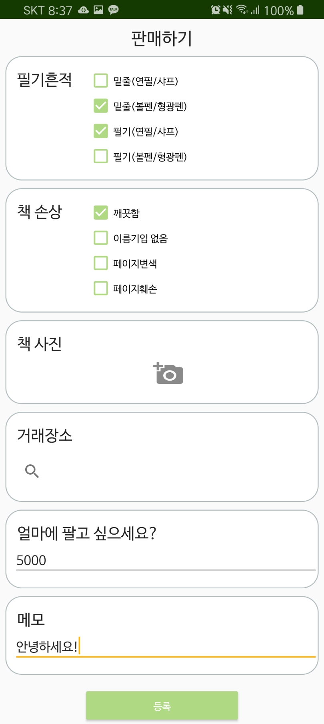
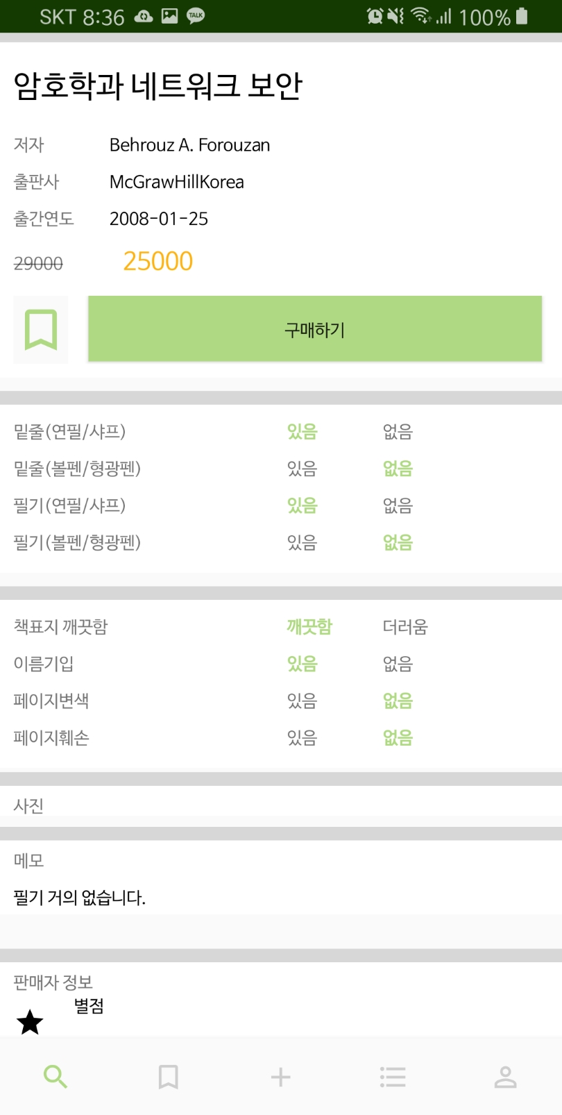
3. Register Book & Detail View

Slide 20
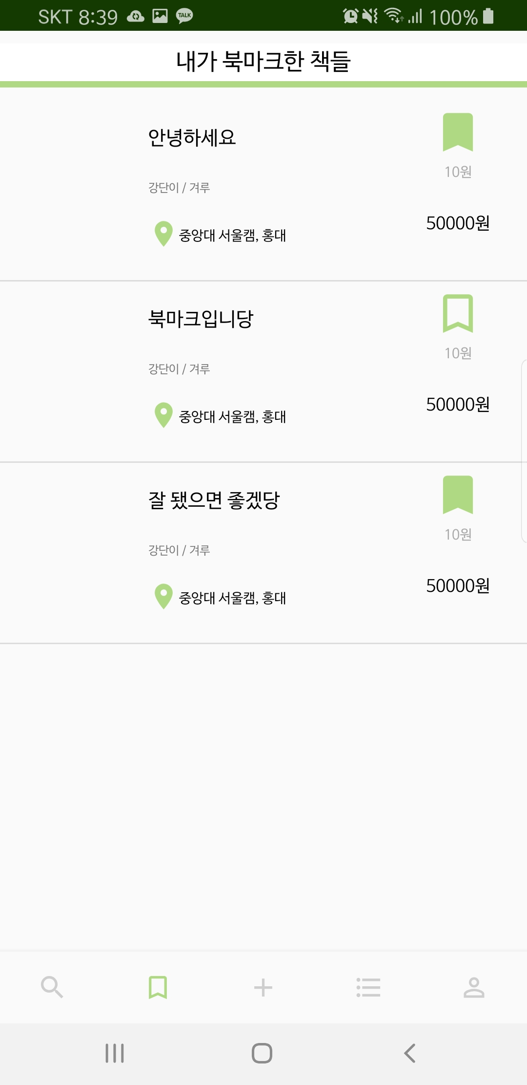
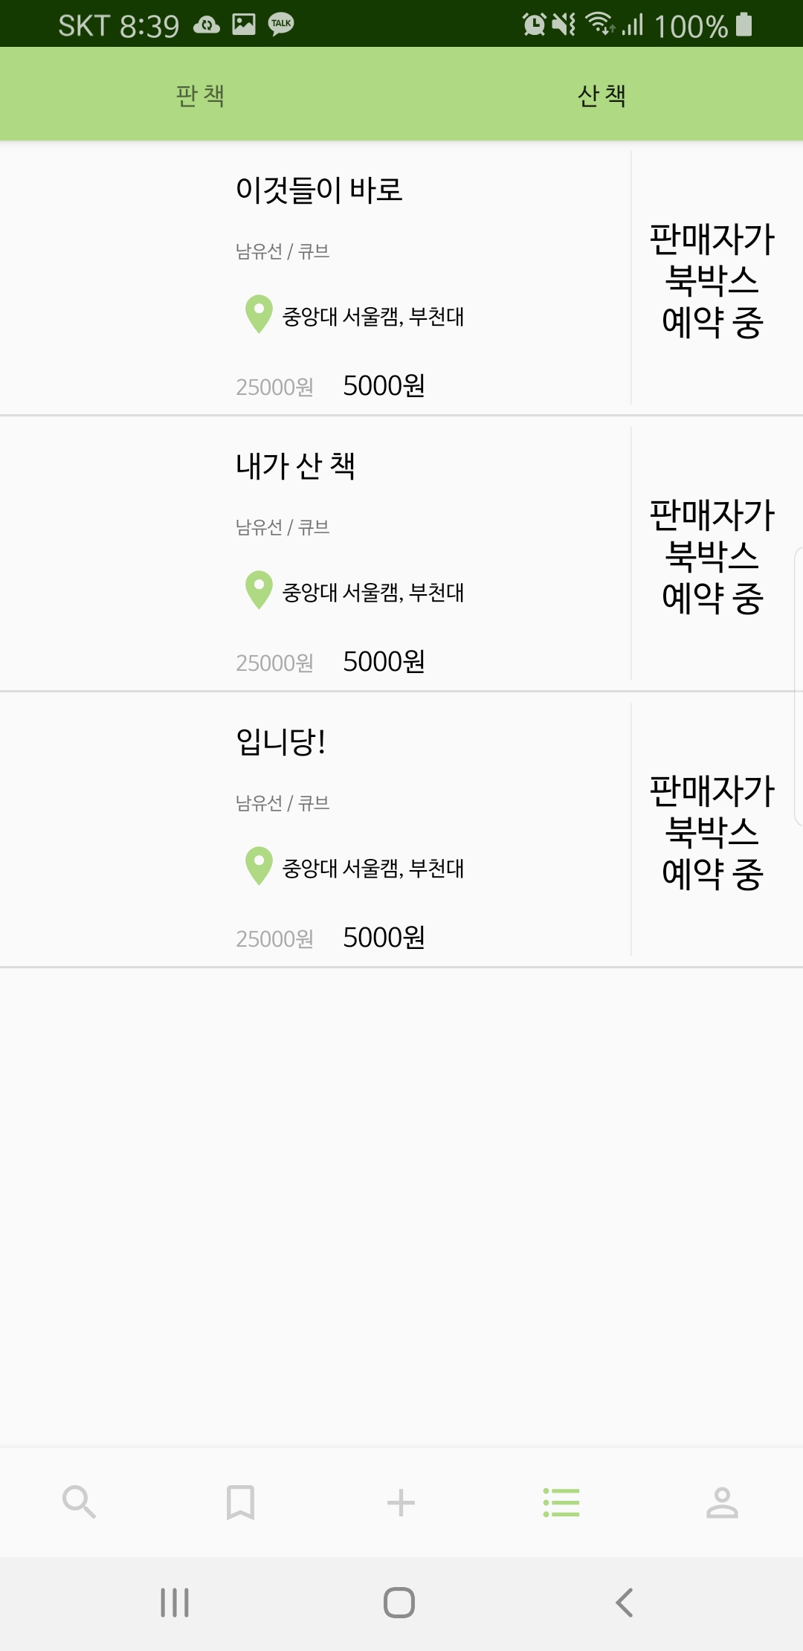
4. Bookmark & Buy list

Slide 21
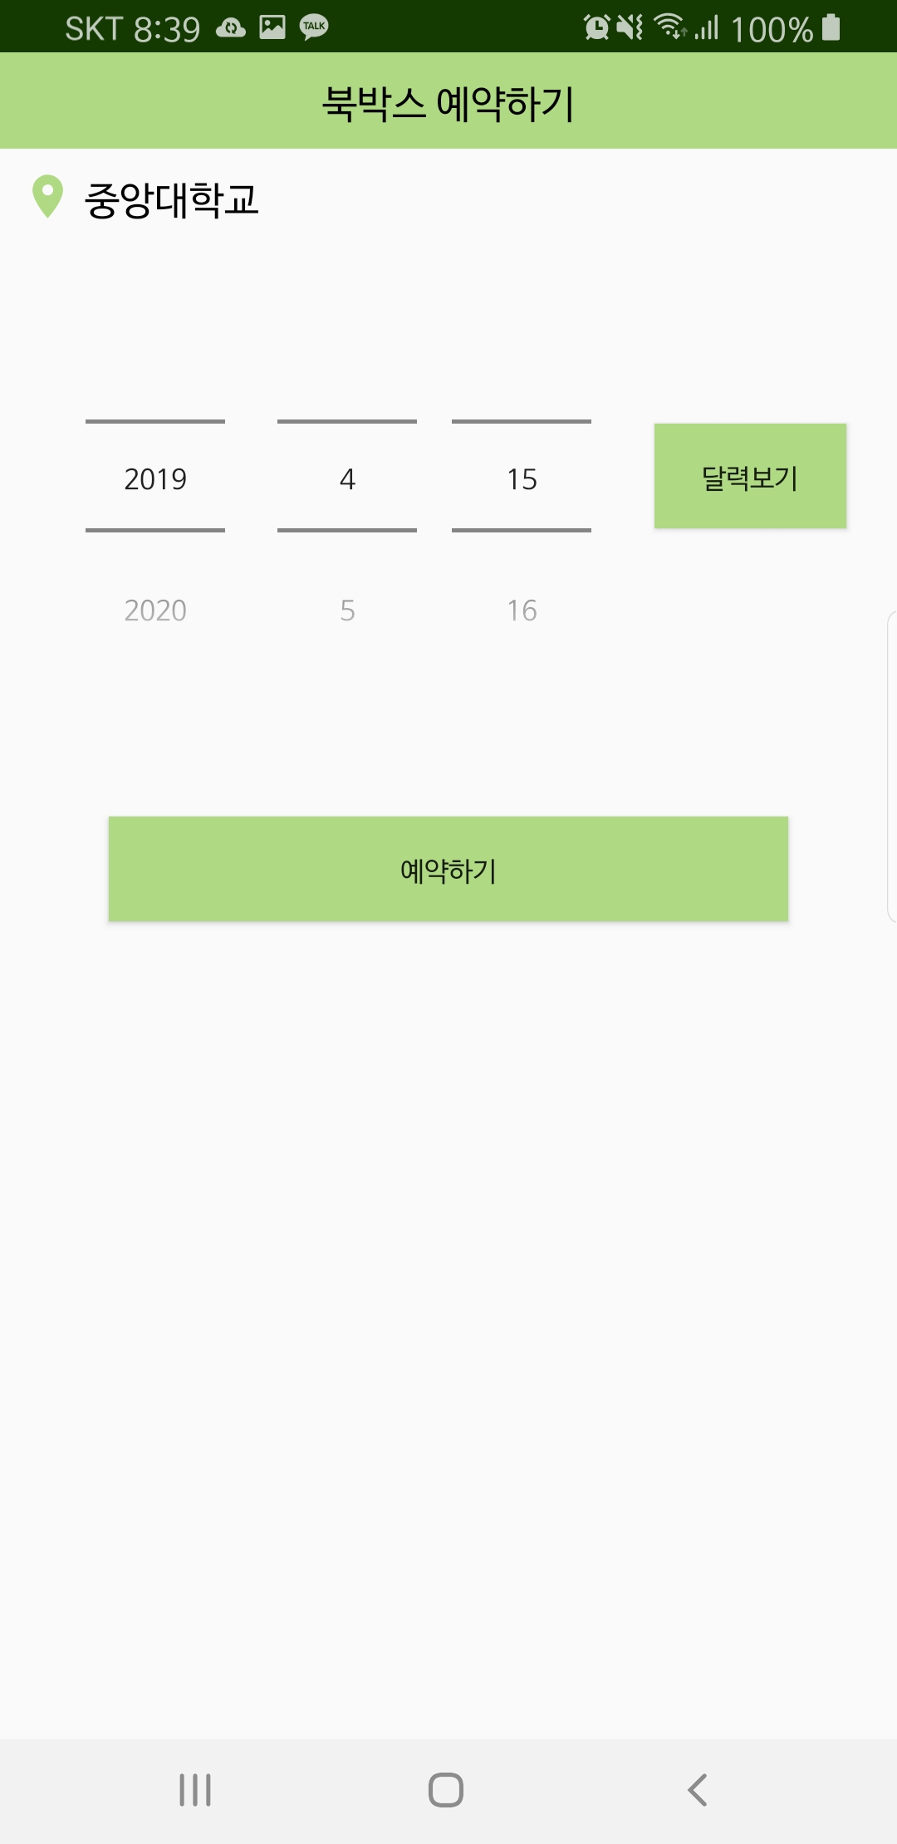
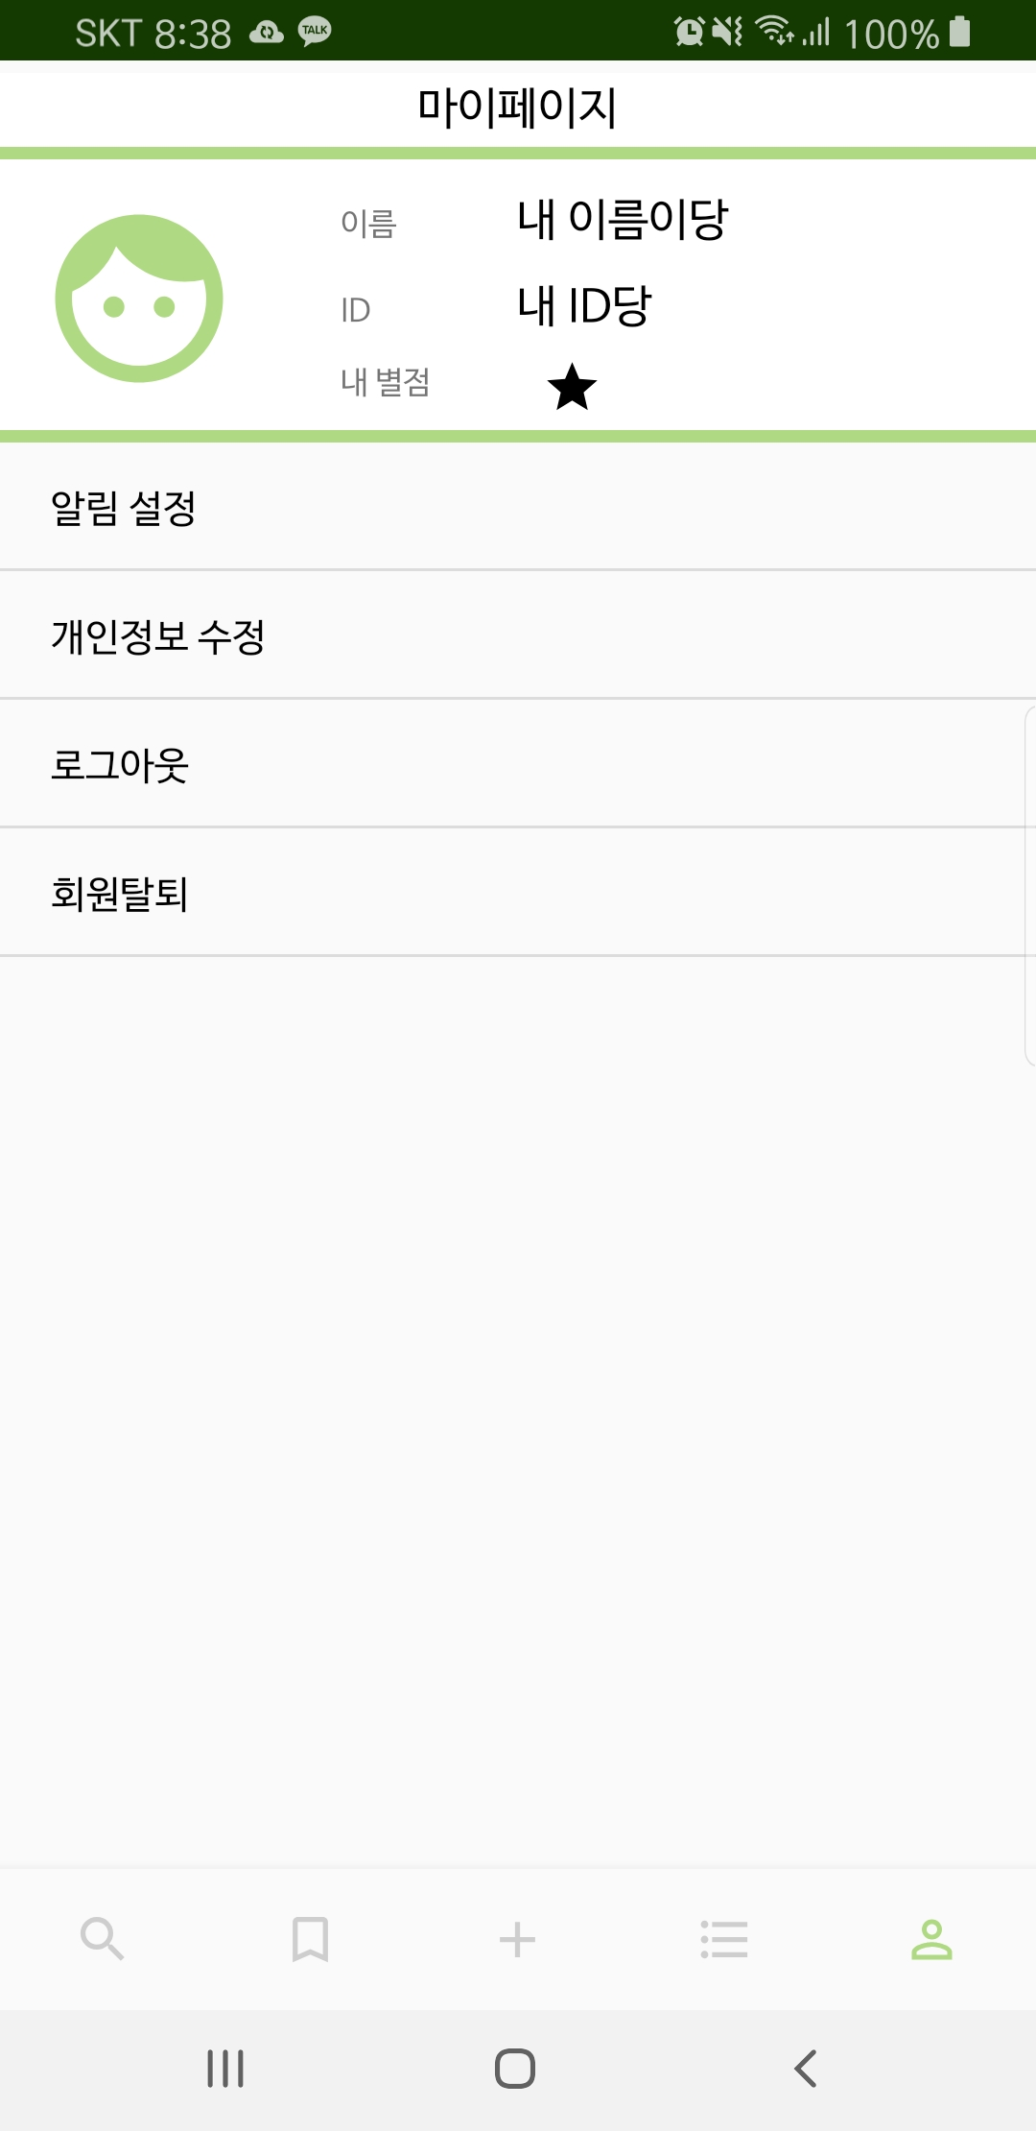
5. BookBox Reservation page & My Page

Slide 22
4
What to Do

Slide 23
What to do
Remaining Application Functions
My page
Payment
QR code
Rating sellers
Upload Pictures
Search transaction spot
ListView
2. Book Box Hardware
3. Book Box Hub-system (Raspberry Pi)

Slide 24
Hoyun Ko
Yuseon Nam
Seungyun Lee
Raspberry Pi Setting

Slide 25
Q&A

